Slide 1
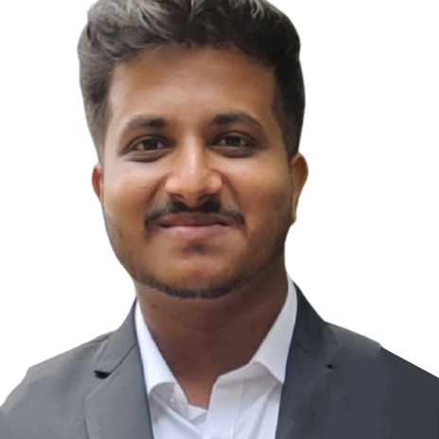


SHARATH C
Analyst/Software Engineer
BACHELOR OF ENGINEERING
Mechanical Engineering
2018-2021
Skills C#
Dot Net core
MS-SQL
.NET Core MVC.
Excel.
Database
MS SQL Server 2014
Web Technologies
HTML
CSS
AddOns
Github
Postman
Additional skills
Leadership Qualities
Quick Learner
Team Management
Better understanding of functional things
BANGALORE
sharath.a.c@capgemini.com
+91 7204695273
A4
Eager to work in a team of dedicated people and serve a key role in the enhancement and development of the project.
Software Engineer who is Strong in design and integration with intuitive problem-solving skills. Passionate about implementing and launching new projects.
Ready to learn new technologies and implement them to further improve my knowledge.
Hands on experience in C#, ASP.NET MVC Framework, HTML, CSS and SQL Server.
Medicine Management System :
Completed end to end case study of medicine Management System using entity framework along with Postman.
Certifications
Microsoft Azure Fundamentals Certificate :AZ-900
Microsoft Certified : Azure Administrator Associate-Az 104
Coursera: Agile Software Development.
Check out my work on GitHub Profile

